Slide 1

DATA STRUCTURES
UNIT-2
Dr. Nagarathna N
PROFESSOR
B.M.S. COLLEGE OF ENGINEERING

Slide 2
UNIT 2 : LINKED LIST
Dr. Nagarathna N
PROFESSOR
B.M.S. COLLEGE OF ENGINEERING

Slide 3
UNIT 2
Linear list: Singly linked list implementation, insertion, deletion and searching operations on linear list, circularly linked lists- insertion, deletion and searching operations for circularly linked lists, doubly linked list implementation, insertion, deletion and searching operations, maintaining directory of names, Manipulation of polynomials (addition), representing sparse matrices.

Slide 4

Linked List
Linked List is a very commonly used linear data structure which consists of group of nodes in a sequence.
Each node holds its own data and the address of the next node hence forming a chain like structure.
Linked Lists are used to create trees and graphs.

Slide 5
Advantages of Linked Lists
They are a dynamic in nature which allocates the memory when required.
Insertion and deletion operations can be easily implemented.
Stacks and queues can be easily executed.

Slide 6
Disadvantages of Linked Lists
The memory is wasted as pointers require extra memory for storage.
No element can be accessed randomly; it has to access each node sequentially.
Reverse Traversing is difficult in linked list.

Slide 7
Applications of Linked Lists
Linked lists are used to implement stacks, queues, graphs, etc.
Linked lists let you insert elements at the beginning and end of the list.
In Linked Lists we don't need to know the size in advance.

Slide 8
Applications of Linked Lists in the Real World:
In music players, we can create our song playlist and can play a song either from starting or ending of the list. And these music players are implemented using a linked list.
We watch the photos on our laptops or PCs, and we can simply see the next or previous images easily. This feature is implemented using a linked list.
You must be reading this article on your web browser, and in web browsers, we open multiple URLs, and we can easily switch between those URLs using the previous and next buttons because they are connected using a linked list.

Slide 9
Types of Linked Lists
Singly Linked List
Doubly Linked List
Circular Linked List

Slide 10
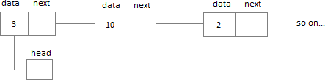
Singly Linked List
Singly linked lists contain nodes which have a data part as well as an address part i.e. next, which points to the next node in the sequence of nodes.
The operations we can perform on singly linked lists are insertion, deletion and traversal.

Slide 11
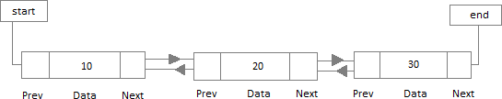
Doubly Linked List
In a doubly linked list, each node contains a data part and two addresses, one for the previous node and one for the next node.

Slide 12
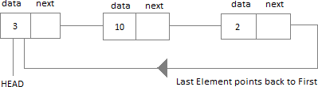
Circular Linked List
In circular linked list the last node of the list holds the address of the first node hence forming a circular chain.

Slide 13
Applications of Singly Linked List :
The singly linked list is used to implement stack and queue.
The undo or redo options, the back buttons, etc., that we discussed above are implemented using a singly linked list.
During the implementation of a hash function, there arises a problem of collision, to deal with this problem, a singly linked list is used.

Slide 14
Application of Doubly Linked Lists :
The doubly linked list is used to implement data structures like a stack, queue, binary tree, and hash table.
It is also used in algorithms of LRU (Least Recently used) and MRU(Most Recently Used) cache.
The undo and redo buttons can be implemented using a doubly-linked list.
The doubly linked list can also be used in the allocation and deallocation of memory.

Slide 15
Applications of Circular Linked Lists :
The circular linked list can be used to implement queues.
In web browsers, the back button is implemented using a circular linked list.
In an operating system, a circular linked list can be used in scheduling algorithms like the Round Robin algorithm.
The undo functionality that is present in applications like photo editors etc., is implemented using circular linked lists.
Circular linked lists can also be used to implement advanced data structures like MRU (Most Recently Used) lists and Fibonacci heap.

Slide 16
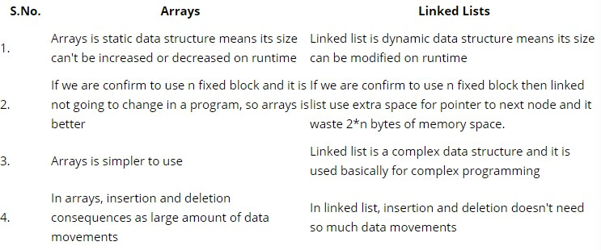
Difference between Arrays and Linked List

Slide 17
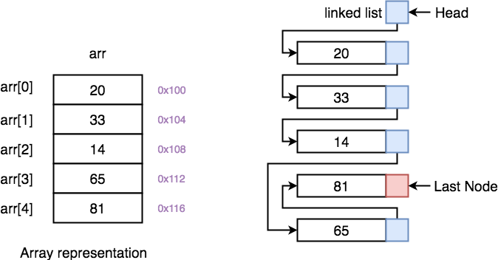

Slide 18
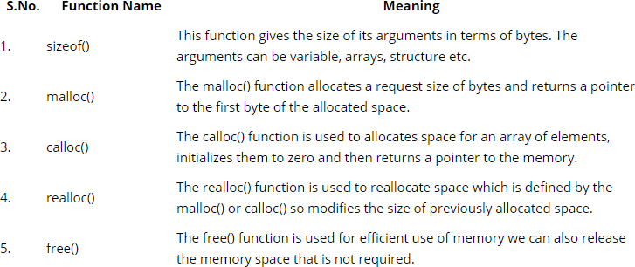
Dynamic Memory Allocation Functions

Slide 19
Example
Syntax for malloc():
ptr=(datatype *)malloc(specified-size);
Example 1:
int *ptr; ptr=(int*)malloc(10*sizeof(int));
Example 2:
struct *str;
str=(struct node*)malloc(sizeof(struct node));
NOTE: malloc and calloc functions return a void pointer, therefore, they can allocate a memory for any type of data. They are used to allocate memory at run time.

Slide 20
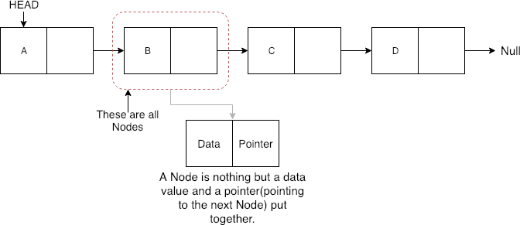
Singly Linked List
What is a Node?
A Node in a linked list holds the data value and the pointer which points to the location of the next node in the linked list.

Slide 21
Node Implementation
// A linked list node struct (Self-referential structures: structure that contain a reference to the data of its same type)
struct Node
{
int data;
struct Node *next;
};
typedef struct Books {
char title[50];
char author[50];
char subject[100];
int book_id;
struct Books *add;
} Book;

Slide 22
Node Implementation
#include<stdio.h>
#include<stdlib.h>
struct node
{
int data;
struct node *link;
};
int main(){
struct node *head=NULL;
//A pointer to a structure is never itself a structure, but merely a variable that holds the address of a structure.
head=(struct node *) malloc(sizeof(struct node));
head->data=16;
head->link=NULL;
printf(“%d”, head->data);
return 0;
}

Slide 23
Node Implementation
#include<stdio.h>
#include<stdlib.h>
struct node
{
int data;
struct node *link;
};
int main(){
struct node *head =(struct node *) malloc(sizeof(struct node)); head->data=16;
head->link=NULL;
struct node *current =(struct node *) malloc(sizeof(struct node)); current ->data=50;
head->link= current;
return 0;
}

Slide 24
Node Implementation
16
2000
50
NULL
1000
2000
he
2000
1000
Head
Current
struct node *head =(struct node *) malloc(sizeof(struct node)); head->data=16;
head->link=NULL;
struct node *current =(struct node *) malloc(sizeof(struct node)); current ->data=50;
head->link= current;

Slide 25
Node Implementation
16
2000
50
NULL
70
NULL
1000
2000
3000
he
2000
3000
1000
Head
Current1
Current2
head->link=current1
current1->link=current2
head->link->link=current

Slide 26
Display the contents of the linked list
void print_list(struct node* head)
{ if (head==NULL)
printf(“Linked list is empty”);
struct node *ptr=head;
while(ptr!=NULL)
{printf(“%d”, ptr->data);
ptr= ptr->link;
}
}

Slide 27
Inserting a node
A node can be added in three ways
At the front of the linked list
After a given node.
At the end of the linked list.

Slide 28
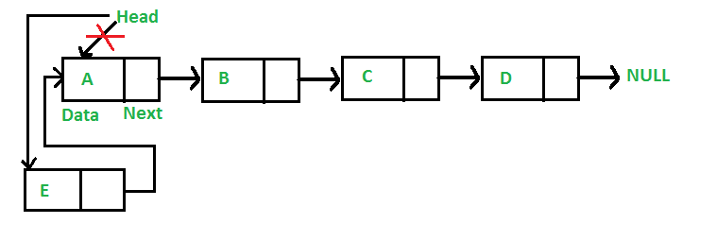
To insert a node at the start/beginning/front of a Linked List, we need to:
Make the first node of Linked List linked to the new node
Remove the head from the original first node of Linked List
Make the new node as the Head of the Linked List.

Slide 29
struct node {
int data;
struct node *next;
};
struct node *head = NULL, *current = NULL;
// display the list
void printList()
{
struct node *p = head;
//start from the beginning of list
while(p != NULL) {
printf(" %d ",p->data);
p = p->next;
}
}

Slide 30
//insertion at the beginning
void insertatbegin(int data)
{
//create a new node
struct node *newnode = (struct node*) malloc(sizeof(struct node));
newnode->data = data;
// point it to old first node
newnode->next = head;
//point first to new first node
head = newnode;
}

Slide 31
void main()
{
insertatbegin(12);
printList();
insertatbegin(22);
printList();
insertatbegin(32);
printList();
insertatbegin(42);
printList();
}
Output
[ 12 ->]
[ 22 -> 12 ->]
[ 32 -> 22 -> 12 ->]
[ 42 -> 32 -> 22 -> 12 ->]

Slide 32
//insertion at the end
void insertatend(int data)
//create a newnode
struct node *newnode;
newnode= (struct node*) malloc(sizeof(struct node));
newnode->data = data;
struct node *save = head;
// point it to last node by traversing
while(save->next != NULL)
save = save->next;
//link to new first node
save->next = newnode;
}

Slide 33
void main()
{
insertatbegin(12);
printList();
insertatbegin(22);
printList();
insertatbegin(32);
printList();
insertatbegin(42);
printList();
insertatend(30);
printList();
insertatend(44);
printList();
insertatbegin(50);
printList();
}
[ 12 ->]
[ 22 -> 12 ->]
[ 32 -> 22 -> 12 ->]
[ 42 -> 32 -> 22 -> 12 ->]
[ 42 -> 32 -> 22 -> 12 -> 30 ->]
[ 42 -> 32 -> 22 -> 12 -> 30 -> 44 ->]
[ 50 -> 42 -> 32 -> 22 -> 12 -> 30 -> 44 ->]

Slide 34
void insertafternode(struct node *list, int data)
{
struct node *lk = (struct node*) malloc(sizeof(struct node));
lk->data = data;
lk->next = list->next;
list->next = lk;
}

Slide 35
void main()
{
insertatbegin(12);
insertatbegin(22);
insertatend(30);
insertatend(44);
insertatbegin(50);
insertafternode(head->next->next, 33);
printf("Linked List: ");
[ 12 ->]
[ 22 -> 12 ->]
[ 22 -> 12 -> 30 ->]
[ 22 -> 12 -> 30 -> 44 ->]
[ 50 -> 22 -> 12 -> 30 -> 44 ->]
Linked List:
[ 50 -> 22 -> 12 -> 33 -> 30 -> 44 ->]

Slide 36
void deleteatbegin()
{
head = head->next;
// how do we free the deleted node?
}
void deleteatend()
{
struct node *linkedlist = head;
while (linkedlist->next->next != NULL)
linkedlist = linkedlist->next;
linkedlist->next = NULL;
}

Slide 37
[ 12 ->]
[ 22 -> 12 ->]
[ 22 -> 12 -> 30 ->]
[ 22 -> 12 -> 30 -> 44 ->]
[ 50 -> 22 -> 12 -> 30 -> 44 ->]
Linked List:
[ 50 -> 22 -> 12 -> 33 -> 30 -> 44 ->]
Linked List after deleting first node:
[ 22 -> 12 -> 33 -> 30 -> 44 ->]
Linked List after deleting last node
[ 22 -> 12 -> 33 -> 30 ->]
Linked List after deletion of given node 12
[ 22 -> 33 -> 30 ->]

Slide 38
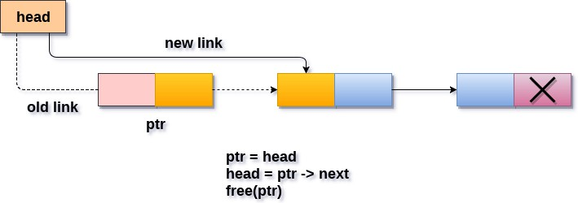
Delete a node at the front
void Pop()
{
struct node *ptr;
if(head == NULL)
{
printf("\nList is empty");
}
else
{
ptr = head;
head = ptr->next;
free(ptr);
printf("\n Node deleted from the begining ...");
}
}

Slide 39
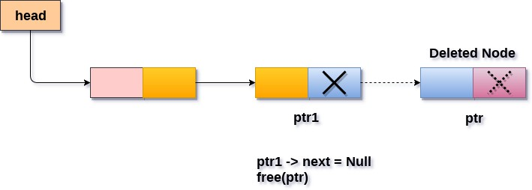
Delete a node at the end
void end_delete()
{
struct node *ptr,*ptr1;
if(head == NULL)
{
printf("\nlist is empty");
}
else if(head -> next == NULL)
{
free(head); head = NULL;
printf("\nOnly node of the list deleted ...");
}
else
{
ptr = head;
while(ptr->next != NULL)
{
ptr1 = ptr;
ptr = ptr ->next;
}
ptr1->next = NULL; free(ptr);
printf("\n Deleted Node from the last ...");
}
}

Slide 40
Singly Linked List Implementation
#include <stdio.h>
#include <stdlib.h>
struct node
{
int info;
struct node *next;
};
typedef struct node *NODE;
NODE insertFront(NODE first);
NODE insertRear(NODE first);
NODE insertAfter(NODE first);
NODE insertBefore(NODE first);
NODE insertAtPos(NODE first);
NODE deleteFront(NODE first);
NODE deleteRear(NODE first);
NODE deleteAfterEle(NODE first);
NODE deleteBeforeEle(NODE first);
NODE deleteElement(NODE first);
NODE deletePos(NODE first);
void display(NODE first);

Slide 41
Singly Linked List Implementation
*****Singly linked list implementation*****
1. Insert Front
2. Insert rear
3. Insert After
4. Insert Before
5. Insert At Position
6. Delete Front
7. Delete Rear
8. Delete After
9. Delete Before
10. Delete Element
11. Delete At Position
12. Display
13. Exit
***********
Enter your choice
void main()
{
NODE first=NULL;
int choice;
while(1)
{
printf("\n\n*****Singly linked list implementation*****");
printf("\n 1. Insert Front \n 2. Insert rear \n 3. Insert After \n
4. Insert Before \n 5. Insert At Position \n
6. Delete Front \n 7. Delete Rear \n
8. Delete After \n 9. Delete Before \n 10. Delete Element \n
11. Delete At Position \n 12. Display \n 13. Exit");
printf("\n\t***********");
printf("\nEnter your choice ");
scanf("%d",&choice);

Slide 42
Singly Linked List Implementation
switch (choice)
{
case 1: first=insertFront(first); break;
case 2: first=insertRear(first); break;
case 3: first=insertAfter(first); break;
case 4: first=insertBefore(first); break;
case 5: first=insertAtPos(first); break;
case 6: first=deleteFront(first); break;
case 7: first=deleteRear(first); break;
case 8: first=deleteAfterEle(first); break;
case 9: first=deleteBeforeEle(first); break;
case 10: first=deleteElement(first); break;
case 11: first=deletePos(first); break;
case 12: display(first); break;
case 13: printf("\n Program exits now"); exit(0);
default: printf("enter valid choice");
}
}
}

Slide 43
Display
void display(NODE first)
{
NODE cur;
if(first==NULL)
printf("No elements to display");
else
{
cur=first;
printf("\n Elements of Singly linked list are:\t");
while(cur!=NULL)
{
printf("%d\t",cur->info);
cur=cur->next;
}
}
}

Slide 44
Insert in Front
NODE insertFront(NODE first)
{
NODE temp=NULL;
temp=(NODE)malloc(sizeof(struct node));
if (temp==NULL)
{
printf("Insufficient memory");
return first;
}
printf("\n Enter element to be inserted");
scanf("%d",&temp->info);
temp->next=NULL;
if(first==NULL)
first=temp;
else {
temp->next=first;
first=temp;
return first;
}
}

Slide 45
Insert at Rear
NODE insertRear(NODE first)
{
NODE temp=NULL,cur=NULL;
temp=(NODE)malloc(sizeof(struct node));
if (temp==NULL)
{
printf("Insufficient memory");
return first;
}
printf("\n Enter element to be inserted");
scanf("%d",&temp->info);
temp->next=NULL;
if(first==NULL)
first=temp;
else
{
cur=first;
while(cur->next!=NULL)
{
cur=cur->next;
}
cur->next=temp;
} return first; }

Slide 46
Insert After an item
NODE insertAfter(NODE first)
{
NODE temp=NULL,cur=NULL;
temp=(NODE)malloc(sizeof(struct node));
if (temp==NULL)
{
printf("Insufficient memory");
return first;
}
int ele,item;
if(first==NULL)
{
printf("linked list is empty");
return first;
}
printf("\n Enter element after which new node to be inserted");
scanf("%d",&ele);

Slide 47
Insert After an item
Elements of Singly linked list are: 2 1 3
cur=first;
while(cur!=NULL&&cur->info!=ele)
cur=cur->next;
if(cur==NULL)
{
printf("Element not found");
return first;
}
printf("\nEnter element to be inserted");
scanf("%d",&item);
temp->info=item;
temp->next=NULL;
temp->next=cur->next;
cur->next=temp;
return first;
}
*****Singly linked list implementation*****
1. Insert Front
2. Insert rear
3. Insert After
4. Insert Before
5. Insert At Position
6. Delete Front
7. Delete Rear
8. Delete After
9. Delete Before
10. Delete Element
11. Delete At Position
12. Display
13. Exit
***********
Enter your choice 3
Enter element after which new node to be inserted 1
Enter element to be inserted5
Enter your choice 12
Elements of Singly linked list are: 2 1 5 3

Slide 48
Insert Before an item
NODE insertBefore(NODE first)
{
NODE temp=NULL, cur=NULL, prev=NULL;
int ele,item;
temp=(NODE)malloc(sizeof(struct node));
if (temp==NULL)
{
printf("Insufficient memory");
return first;
}
printf("\n Enter element before which new node to be inserted");
scanf("%d",&ele);

Slide 49
Insert Before an item
Elements of Singly linked list are: 2 1 3
cur=first;
while(cur!=NULL&&cur->info!=ele)
{ prev=cur;
cur=cur->next; }
if(cur==NULL)
{ printf("Element not found");
return first; }
printf("Element to be inserted");
scanf("%d",&item);
temp->info=item;
temp->next=NULL;
temp->next=cur;
if(prev!=NULL)
prev->next=temp;
else
first=temp;
return first;
}

Slide 50
Insert at Position
NODE insertAtPos(NODE first)
{
NODE temp=NULL,cur=NULL;
temp=(NODE)malloc(sizeof(struct node));
if (temp==NULL)
{
printf("Insufficient memory");
return first;
}
int ele,pos;
if(first==NULL)
{
printf("linked list is empty");
return first;
}

Slide 51
Insert at Position
printf("Enter pos at which new element to be inserted ");
scanf("%d",&pos);
printf("Enter element to be inserted at pos ");
scanf("%d",&ele);
if(pos==1)
{
first=insertFront(first);
return first;
}

Slide 52
Insert at Position
Elements of Singly linked list are: 2 6 1 5 3
cur=first;
int i=1;
while(cur!=NULL&&i<pos-1)
{
cur=cur->next;
i++;
}
if(cur==NULL)
{
printf("Element not found");
return first;
}
temp->info=ele;
temp->next=NULL;
temp->next=cur->next;
cur->next=temp;
return first;
}
*****Singly linked list implementation*****
1. Insert Front
2. Insert rear
3. Insert After
4. Insert Before
5. Insert At Position
6. Delete Front
7. Delete Rear
8. Delete After
9. Delete Before
10. Delete Element
11. Delete At Position
12. Display
13. Exit
***********
Enter your choice 5
Enter pos at which new element to be inserted 4
Enter element to be inserted at pos 7
Enter your choice 12
Elements of Singly linked list are: 2 6 1 7 5 3

Slide 53
Delete Front
NODE deleteFront(NODE first)
{
NODE temp=NULL;
if(first==NULL)
{
printf("Linked List is empty, create Linked list");
return first;
}
temp=first;
first=first->next;
printf("Element being deleted is %d",temp->info);
free(temp);
return first;
}

Slide 54
Delete Rear
NODE deleteRear(NODE first)
{
NODE cur=NULL,prev=NULL;
prev=(NODE)malloc(sizeof(struct node));
if (prev==NULL)
{
printf("Insufficient memory");
return first;
}
if(first==NULL)
{
printf("LL is empty");
return first;
}

Slide 55
Delete Rear
cur=first;
prev=NULL;
while(cur->next!=NULL)
{
prev=cur;
cur=cur->next;
}
prev->next=NULL;
printf("Element being deleted is %d",cur->info);
free(cur);
return first;
}

Slide 56
Delete Element
NODE deleteElement(NODE first)
{
NODE cur = NULL, prev = NULL;
int item;
if(first==NULL)
{
printf("\nThe list is empty\n");
return first;
}
printf("\nEnter the element to be deleted :");
scanf("%d",&item);

Slide 57
Delete Element
cur=first;
while(cur!=NULL && cur->info!=item)
{ prev=cur;
cur=cur->next; }
if(cur==NULL)
{ printf("\nElement to be deleted doesnt exist in the list\n");
return first; }
if(prev==NULL)
{ first = deleteFront(first);
return first; }
prev->next = cur->next;
printf("\nElement being deleted is : %d\n", cur->info);
free(cur);
return first;
}

Slide 58
Delete at Position
NODE deletePos(NODE first)
{
NODE cur = NULL, prev = NULL;
int pos, k;
if(first==NULL)
{ printf("\nThe list is empty.. no elements to delete...\n");
return first;
}
printf("\nEnter the position of element to be deleted :");
scanf("%d",&pos);
if(pos==1)
{
first = deleteFront(first);
return first;
}

Slide 59
Delete at Position
cur=first;
k=1;
while(cur!=NULL && k<pos)
{ prev=cur;
cur=cur->next;
k++;
}
if(cur==NULL)
{ printf("\nPosition doesnt exist in the list\n");
return first; }
prev->next = cur->next;
printf("\nElement being deleted is : %d\n", cur->info);
free(cur);
return first;
}

Slide 60
Delete Before Element
NODE deleteBeforeEle(NODE first)
{ NODE cur = NULL, prev = NULL, pprev = NULL;
int ele;
if(first==NULL)
{ printf("\nThe list is empty.. no elements to delete...\n");
return first;
}
printf("\nEnter an element whose left element to be deleted :");
scanf("%d",&ele);
cur=first;
while(cur!=NULL && cur->info!=ele)
{ pprev = prev;
prev=cur;
cur=cur->next;
}

Slide 61
Delete Before Element
if(cur==NULL)
{
printf("\nElement doesnt exist in the list\n");
return first;
}
if(pprev==NULL)
{
first = deleteFront(first);
return first;
}
pprev->next = prev->next;
printf("\nElement being deleted is : %d\n", prev->info);
free(prev);
return first;
}

Slide 62
Delete After Element
NODE deleteAfterEle(NODE first)
{
NODE cur = NULL, temp = NULL;
int ele;
if(first==NULL)
{ printf("\nThe list is empty.. no elements to delete...\n");
return first;
}
printf("\nEnter an element whose right element to be deleted :");
scanf("%d",&ele);
cur=first;
while(cur!=NULL && cur->info!=ele)
{ cur=cur->next;
}

Slide 63
Delete After Element
if(cur==NULL)
{
printf("\nElement doesnt exist in the list\n");
return first;
}
if(cur->next == NULL)
{ printf("\nNo elements to delete after the given element...");
return first;
}
temp = cur->next;
cur->next = temp->next;
printf("\nElement being deleted is : %d\n", temp->info);
free(temp);
return first;
}

Slide 64
Instructions to Students to be followed in each lab:
1. Each Student should write down the program in the observation book and get it evaluated by the respective lab faculty in-charge and then execute the program.
2. Each Student should bring the lab record with the programs and output written for the programs completed in their respective previous week and get it evaluated by the lab faculty in-charge. In the record book students should - Handwrite the Program - Pasting of the printout of the Output or Handwriting of the Output (Output should be written for all the cases).
3. Continuous Internal Evaluation for each lab is for 10 marks which includes execution of the program in the allotted lab time and showing the output. If Leetcode program is present for a particular lab, student needs to complete that also within the allotted lab slot only and show the output. Observation book needs to be corrected on the same day itself.
Note: wherever LeetCode program is present, the program to be executed will be shared during the particular lab week.
Note: Submission during the lab slot: 10 marks
Submission on the same day but after lab slot: 8 marks
Submission within 1 week the program was assigned: 6 marks
Submission within 2 weeks the program was assigned: 5 marks
Submission any later: 0 marks

Slide 65
Lab Program
1. Write a program to implement Singly Linked List with following operations
a) Create a linked list.
b) Insertion of a node at first position, at any position and at end of list.
c) Display the contents of the linked list.
2.Write a program to Implement Singly Linked List with following operations
a) Create a linked list.
b) Deletion of first element, specified element and last element in the list.
c) Display the contents of the linked list.

Slide 66
Singly Linked List:Deleting a node
A node can be deleted in three ways
At the front of the linked list (Beginning)
After a given node/specified position
At the end of the linked list.

Slide 67
Delete a node at the front
First check if the list is empty. If not empty continue
Point head to the next node i.e. second node
temp = head
head = head->next
Make sure to free unused memory
free(temp); or delete temp;

Slide 68
Delete a node at the front
void Pop()
{
struct node *ptr;
if(head == NULL)
{
printf("\nList is empty");
}
else
{
ptr = head;
head = ptr->next;
free(ptr);
printf("\n Node deleted from the begining ...");
}
}

Slide 69
Delete a node at the end

Slide 70
Delete a node at the end
void end_delete()
{
struct node *ptr,*ptr1;
if(head == NULL)
{
printf("\nlist is empty");
}
else if(head -> next == NULL)
{
free(head); head = NULL;
printf("\nOnly node of the list deleted ...");
}
else
{
ptr = head;
while(ptr->next != NULL)
{
ptr1 = ptr;
ptr = ptr ->next;
}
ptr1->next = NULL; free(ptr);
printf("\n Deleted Node from the last ...");
}
}

Slide 71
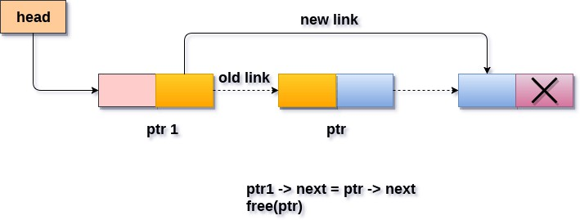
Delete a node at specified position
Steps to delete a node from the linked list:
Find the previous node of the node to be deleted.
Change the next of the previous node.
Free memory for the node to be deleted.

Slide 72
Delete a node at specified position
void delete_specified()
{
struct node *ptr, *ptr1; int loc,i; scanf("%d",&loc); ptr=head; for(i=0;i<loc;i++)
{
ptr1 = ptr;
ptr = ptr->next;
if(ptr == NULL)
{
printf("\nThere are less than %d elements in the list..\n",loc);
return;
}
}
ptr1 ->next = ptr ->next; free(ptr);
printf("\nDeleted %d node ",loc);
}

Slide 73
Singly Linked List Operations
Search
Count number of nodes
Concatenation
Merging
Reversing

Slide 74
Search
Search for an element in the linked list:
Initialize a node pointer, current = head.
Do following while current is not NULL
Get the key to be searched
If the current value (i.e., current->data) is equal to the key being searched return true.
Otherwise, move to the next node (current = current->next).
If the key is not found, return false

Slide 75
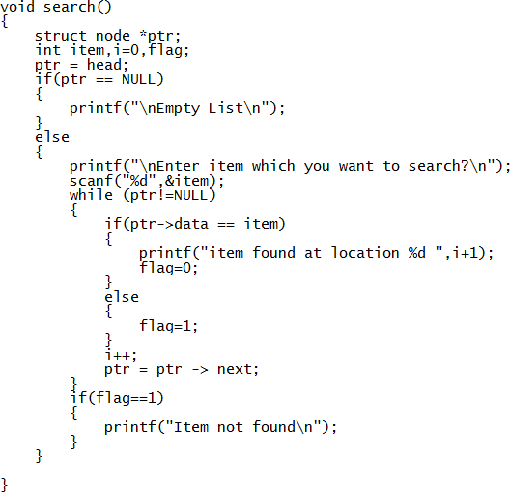
Search

Slide 76
Count number of nodes
void Count_nodes(struct node* head )
{
/* temp pointer points to head */
struct node* temp = head;
/* Initialize count variable */
int count=0;
/* Traverse the linked list and maintain the count */
while(temp != NULL)
{
temp = temp->next;
/* Increment count variable. */
count++;
}
/* Print the total count. */
printf("\n Total no. of nodes is %d",count);
}

Slide 77
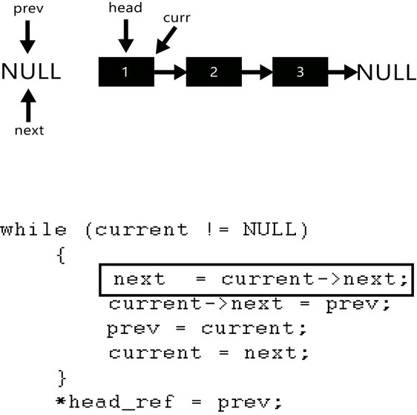
Reversing
Given a pointer to the head node of a linked list, the task is to reverse the linked list. We need to reverse the list by changing the links between nodes.
Input: Head of following linked list 1->2->3->4->NULL Output: Linked list should be changed to, 4->3->2->1->NULL

Slide 78
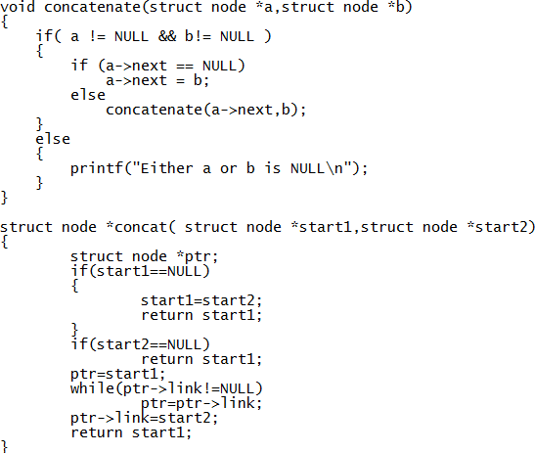
Concatenation

Slide 79
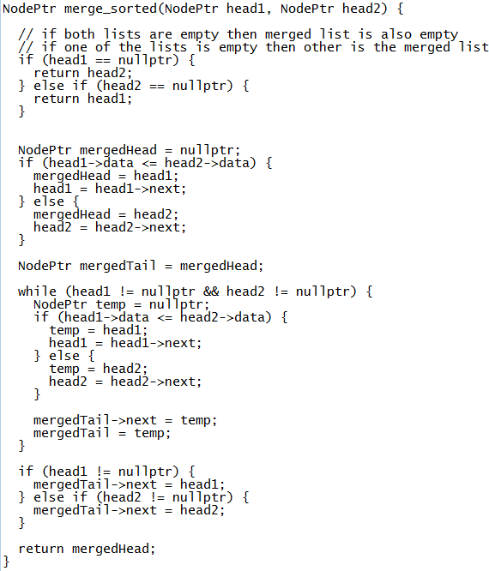
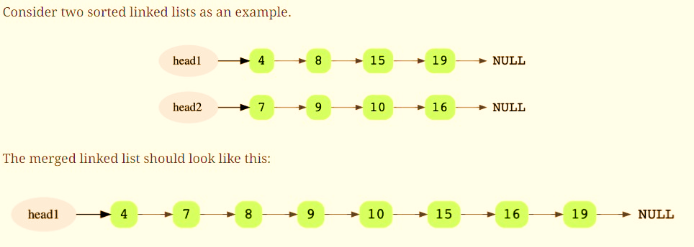
Merging

Slide 80
Lab Program
3. Write a program to Implement Singly Linked List with following operations
a) Sort the linked list.
b) Reverse the linked list.
c) Concatenation of two linked lists

Slide 81
Applications of Linked List
Stack
Queue implementation
Lab Program 9: Write a program to implement Stack & Queues using Linked Representation.

Slide 82
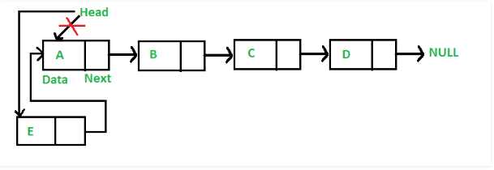
Stack Implementation using Linked List

Slide 83
Stack Implementation using Linked List
void push(struct Node** head_ref, int new_data)
{
struct Node* new_node = (struct Node*) malloc(sizeof(struct Node)); new_node->data = new_data;
new_node->next = (*head_ref); (*head_ref) = new_node;
}
void Pop()
{
struct node *ptr; if(head == NULL)
{
printf("\nList is empty");
}
else
{
ptr = head;
head = ptr->next; free(ptr);
printf("\n Node deleted from the begining ...");
}
}

Slide 84
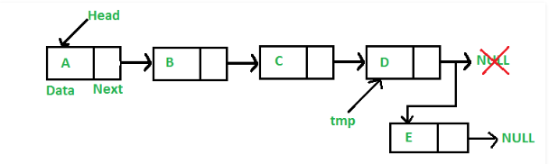
Queue implementation using Linked List

Slide 85
Queue implementation using Linked List
void Enqueue(item)
{
struct node *ptr,*temp;
ptr = (struct node*)malloc(sizeof(struct node));
ptr->data = item; ptr -> next = NULL; if(head == NULL)
{
head = ptr; printf("\nNode inserted");
}
else
{
temp = head;
while (temp -> next != NULL)
{
temp = temp -> next;
}
temp->next = ptr; printf("\nNode inserted");
}
}
Void Dequeue()
{
struct node *ptr; if(head == NULL)
{
printf("\nList is empty");
}
else
{
ptr = head;
head = ptr->next; free(ptr);
printf("\n Node deleted from the begining ...");
}

Slide 86
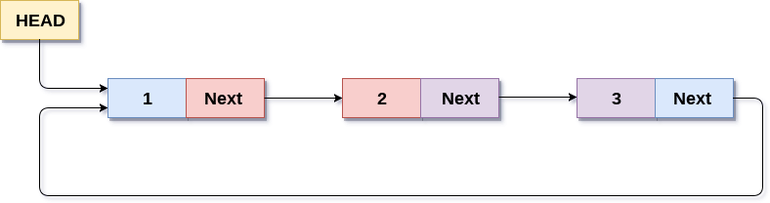
Circular Linked list
In a circular Singly linked list, the last node of the list contains a pointer to the first node of the list. We can have circular singly linked list as well as circular doubly linked list.
We traverse a circular singly linked list until we reach the same node where we started. The circular singly liked list has no beginning and no ending. There is no null value present in the next part of any of the nodes.

Slide 87
Operations on Circular List
Insertion at the beginning
Insertion at the end
Deletion at the beginning
Deletion at the end
Searching
Traversing
void display(NODE first);
NODE insertFront(NODE first);
NODE insertRear(NODE first);
NODE insertAfter(NODE first);
NODE insertBefore(NODE first);
NODE insertAtPos(NODE first);
NODE deleteFront(NODE first);
NODE deleteRear(NODE first);
NODE deleteElement(NODE first);
NODE deleteAtPos(NODE first);
NODE deleteAfterEle(NODE first);
NODE deleteBeforeEle(NODE first);

Slide 88
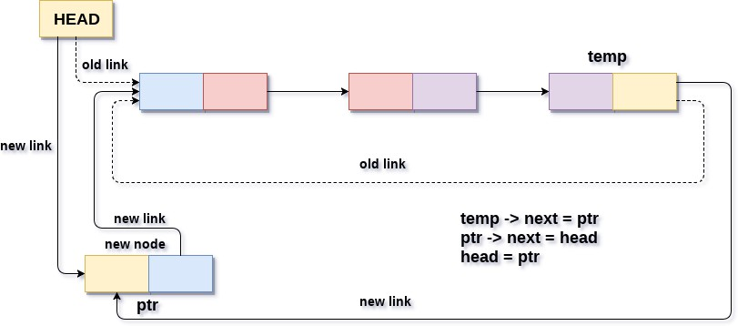
Insertion at the beginning
void beg_insert(int item)
{
struct node *ptr = (struct node *)malloc(sizeof(struct node));
struct node *temp;
if(ptr == NULL)
{
printf("\nOVERFLOW");
}
else
{
ptr -> data = item;
if(head == NULL)
{
head = ptr;
ptr -> next = head;
}
else
{
temp = head;
while(temp->next != head) temp = temp->next;
ptr->next = head; temp -> next = ptr; head = ptr;
}
printf("\nNode Inserted\n");
}

Slide 89
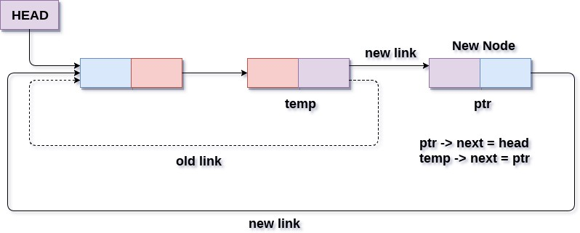
Insertion at the end
void lastinsert(struct node*ptr, struct node *temp, int item)
{
ptr = (struct node *)malloc(sizeof(struct node));
if(ptr == NULL)
{
printf("\nOVERFLOW\n");
}
else
{
ptr->data = item;
if(head == NULL)
{
head = ptr;
ptr -> next = head;
}
else
{
temp = head;
while(temp -> next != head)
{
temp = temp -> next;
}
temp -> next = ptr; ptr -> next = head;
}
}

Slide 90
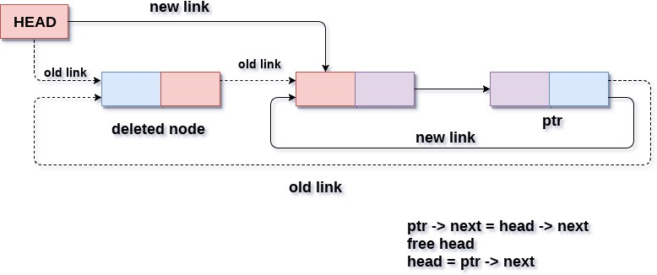
Deletion at the beginning
void beg_delete()
{
struct node *ptr;
if(head == NULL)
{
printf("\nUNDERFLOW\n");
}
else if(head->next == head)
{
head = NULL; free(head);
printf("\nNode Deleted\n");
}
else
{
ptr = head;
while(ptr -> next != head) ptr = ptr -> next;
ptr->next = head->next; free(head);
head = ptr->next; printf("\nNode Deleted\n");
}
}

Slide 91
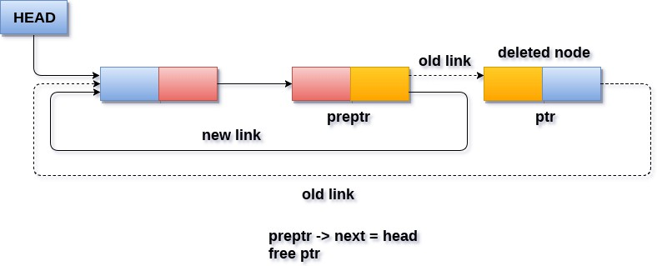
Deletion at the end
void last_delete()
{
struct node *ptr, *preptr;
if(head==NULL)
{
printf("\nUNDERFLOW\n");
}
else if (head ->next == head)
{
head = NULL; free(head);
printf("\nNode Deleted\n");
}
else
{
ptr = head;
while(ptr ->next != head)
{
preptr=ptr;
ptr = ptr->next;
}
preptr->next = ptr -> next; free(ptr);
printf("\nNode Deleted\n");
}
}

Slide 92
Searching
void search()
{
struct node *ptr; int item,i=0,flag=1; ptr = head;
if(ptr == NULL)
{
printf("\nEmpty List\n");
}
else
{
printf("\nEnter item which you want to search?\n"); scanf("%d",&item);
if(head ->data == item)
{
printf("item found at location %d",i+1); flag=0;
return;
}
else
{
while (ptr->next != head)
{
if(ptr->data == item)
{
printf("item found at location %d ",i+1); flag=0;
return;
}
else
{
flag=1;
} i++;
ptr = ptr -> next;
}
}
if(flag != 0)
{
printf("Item not found\n");
return;
}
}

Slide 93
Traversing
void traverse()
{
struct node *ptr; ptr=head;
if(head == NULL)
{
printf("\nnothing to print");
}
else
{
printf("\n printing values ... \n");
while(ptr -> next != head)
{
printf("%d\n", ptr -> data); ptr = ptr -> next;
}
printf("%d\n", ptr -> data);
}
}

Slide 94
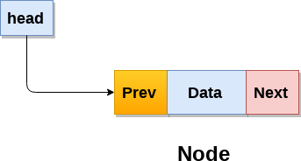
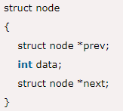
Doubly Linked List

Slide 95
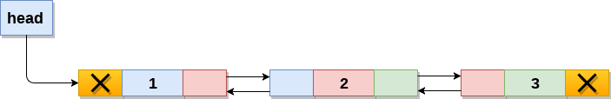
Doubly Linked List

Slide 96
Operations on Doubly Linked List
Insertion at beginning
Insertion at end
Insertion after specified node
Deletion at beginning
Deletion at end
Deletion of the node at given data
Searching
Traversing

Slide 97
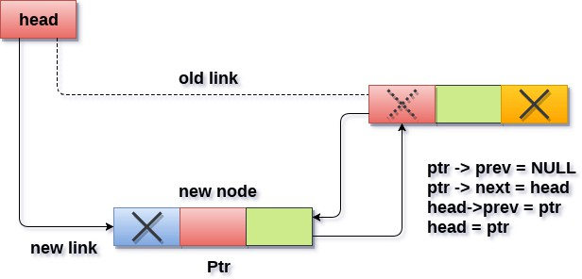
Insertion at beginning

Slide 98
Insertion at beginning
void insertbeginning(int item)
{
struct node *ptr = (struct node *)malloc(sizeof(struct node));
ptr->data=item;
if(head==NULL)
{
ptr->next = NULL;
ptr->prev=NULL;
head=ptr;
}
else
{
ptr->prev=NULL;
ptr->next = head;
head->prev=ptr; head=ptr;
}
}

Slide 99
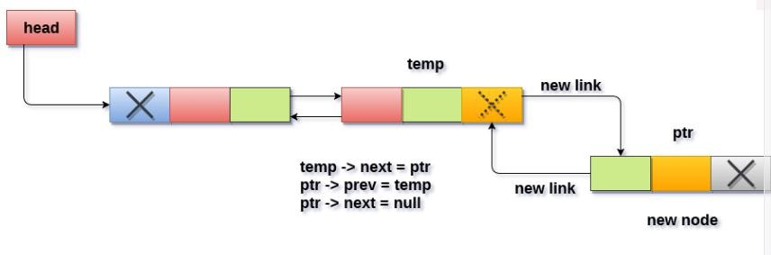
Insertion at end

Slide 100
Insertion at end
void insertlast(int item)
{
struct node *ptr = (struct node *) malloc(sizeof(struct node));
struct node *temp;
ptr->data=item;
if(head == NULL)
{
ptr->next = NULL; ptr->prev = NULL;
head = ptr;
}
else
{
temp = head;
while(temp->next!=NULL)
{
temp = temp->next;
}
temp->next = ptr; ptr ->prev=temp;
ptr->next = NULL;
}
printf("\nNode Inserted\n");
}

Slide 101
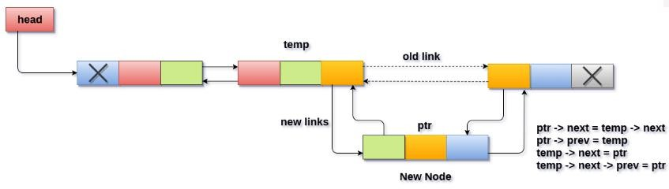
Insert after specified node

Slide 102
Insert after specified node
void insert_specified(int item)
{
struct node *ptr = (struct node *)malloc(sizeof(struct node)); struct node *temp;
int i, loc;
printf("\nEnter the location\n"); scanf("%d",&loc);
temp=head;
for(i=0;i<loc;i++)
{
temp = temp->next;
if(temp == NULL)
{
printf("\ncan't insert\n");
return;
}
}
ptr->data = item;
ptr->next = temp->next;
ptr -> prev = temp; temp->next = ptr;
temp->next->prev=ptr;
printf("Node Inserted\n");
} }

Slide 103
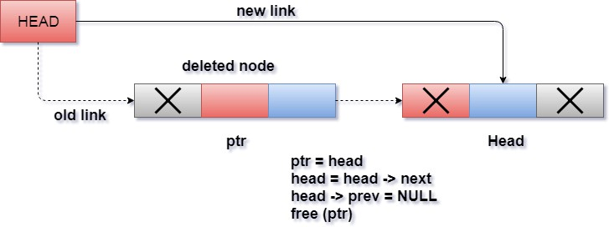
Deletion at beginning

Slide 104
Deletion at beginning
void beginning_delete()
{
struct node *ptr;
if(head == NULL)
{
printf("\n UNDERFLOW\n");
}
else if(head->next == NULL)
{
head = NULL; free(head);
printf("\nNode Deleted\n");
}
else
{
ptr = head;
head = head -> next;
head -> prev = NULL; free(ptr);
printf("\nNode Deleted\n");
}
}

Slide 105
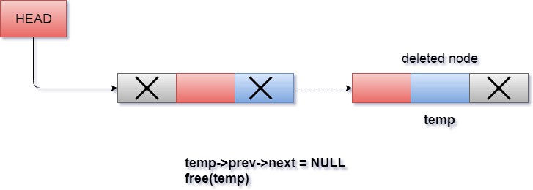
Deletion at end

Slide 106
Deletion at end
void last_delete()
{
struct node *ptr;
if(head == NULL)
{
printf("\n UNDERFLOW\n");
}
else if(head->next == NULL)
{
head = NULL; free(head);
printf("\nNode Deleted\n");
}
else
{
ptr = head;
if(ptr->next != NULL)
{
ptr = ptr -> next;
}
ptr -> prev -> next = NULL; free(ptr);
printf("\nNode Deleted\n");
}
}

Slide 107
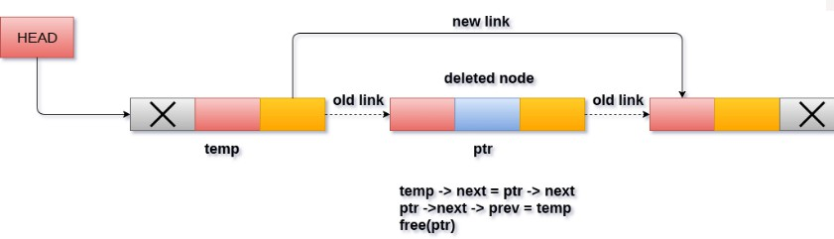
Deletion of a specified node

Slide 108
Deletion of a specified node
void delete_specified( )
{
struct node *ptr, *temp;
int val;
printf("Enter the value"); scanf("%d",&val);
temp = head;
while(temp -> data != val) temp = temp -> next; if(temp -> next == NULL)
{
printf("\nCan't delete\n");
}
else if(temp -> next -> next == NULL)
{
temp ->next = NULL; printf("\nNode Deleted\n");
}
else
{
ptr = temp -> next;
temp -> next = ptr -> next; ptr -> next -> prev = temp; free(ptr);
printf("\nNode Deleted\n");
}
}

Slide 109
Searching
void search()
{
struct node *ptr; int item,i=0,flag; ptr = head;
if(ptr == NULL)
{
printf("\nEmpty List\n");
}
else
{
printf("\nEnter item which you want to search?\n"); scanf("%d",&item);
while (ptr!=NULL)
{
if(ptr->data == item)
{
printf("\nitem found at location %d ",i+1);
flag=0;
break;
}
else
{ flag=1; }
i++;
ptr = ptr -> next;
}
if(flag==1)
{printf("\nItem not found\n");}
}
}

Slide 110
Traversing
int traverse()
{
struct node *ptr;
if(head == NULL)
{
printf("\nEmpty List\n");
}
else
{
ptr = head;
while(ptr != NULL)
{
printf("%d\n",ptr->data); ptr=ptr->next;
}
}
}

Slide 111
Lab Program
Lab Program 4: Write a program to Implement doubly linked list with primitive operations
a) Create a doubly linked list.
b) Insert a new node to the left of the node.
c) Delete the node based on a specific value
d) Display the contents of the list

Slide 112
Useful Links
https://visualgo.net/en/list?slide=1
https://www.cs.usfca.edu/~galles/visualization/Algorithms.html
https://csvistool.com

